Slide 1
How to Request for VOE via E-Trieve

Slide 2
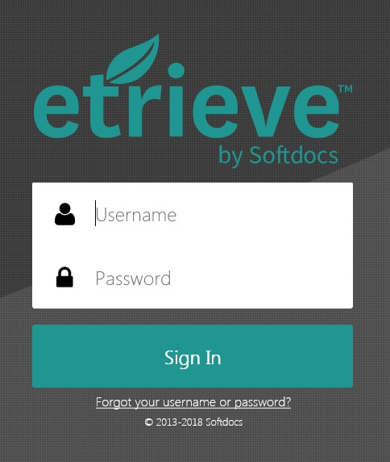
Go to link: http://forms.uog.edu
  You will be prompted to login with a username and password (it will be the same info as your Triton email) – if you are having trouble, please contact Computer Center to reset password (735-2640)

Slide 3
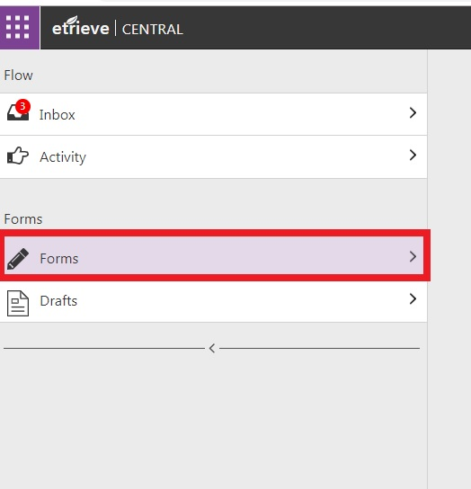
After you log in, click Forms (left of screen)

Slide 4
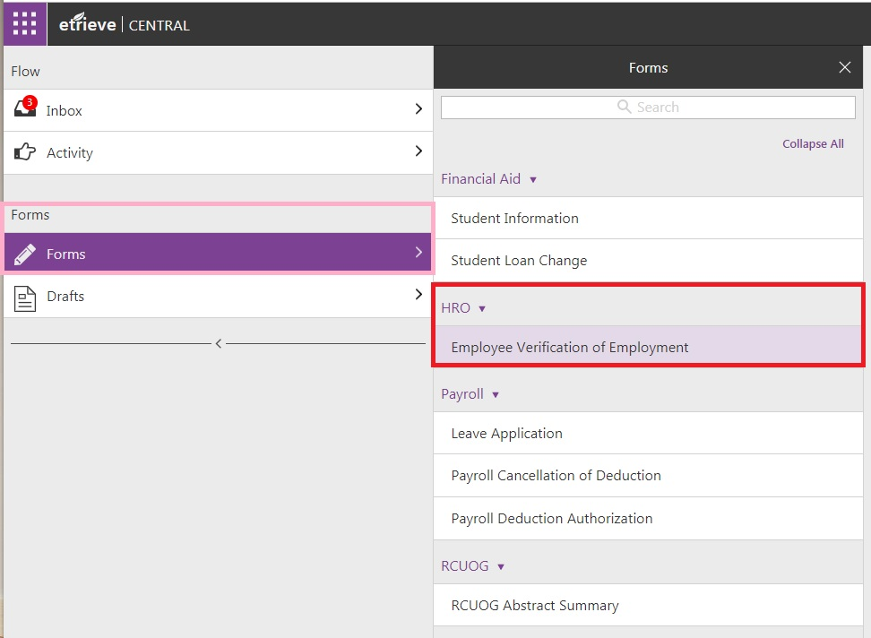
(Forms) Under HRO click Employee Verification of Employment

Slide 5
Proceed to fill in Institution VOE will be prepared for (e.g., Bank of Guam, Coast360, PenFed, Personal Finance Center, University of Guam, etc.)
  When finished, click Submit at bottom left of screen
    (Please see next slide for reference)

Slide 6
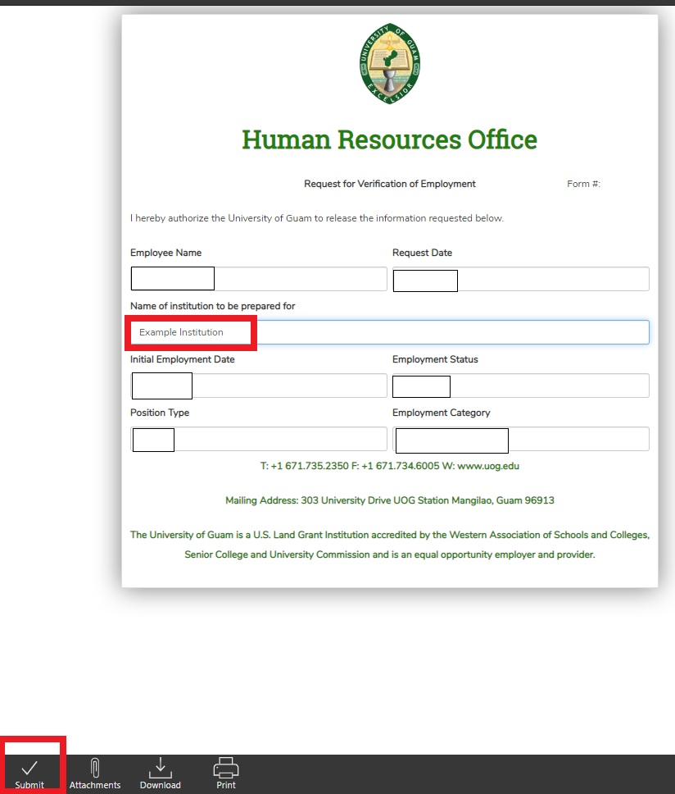
Fill in institution before submission (below Employee Name)
Submit (bottom left of screen)

Slide 7
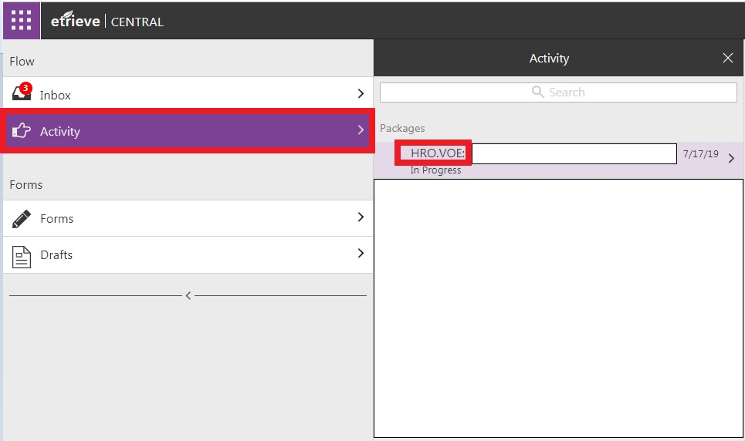
On left side of E-Trieve screen, click Activity
  Click HRO.VOE

Slide 8
Final
Your VOE will be completed with the Acting CHRO’s signature
  You have the option of printing and/or downloading the VOE
    (Please proceed to next slide for reference)

Slide 9
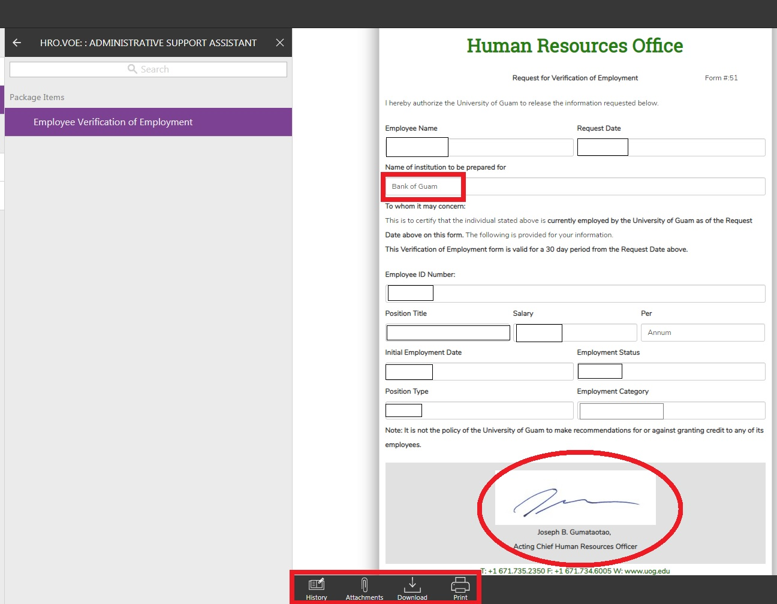
Acting CHRO’s signature
(red circle)
Options to print, download, etc.
(bottom left of screen)

