Slide 1
How to use a microscope
Always start with the scanning objective
Once focused, switch to low power
Focus again, then switch to high power
Adjust lighting as needed
Useful for looking at samples straight from the field

Slide 2
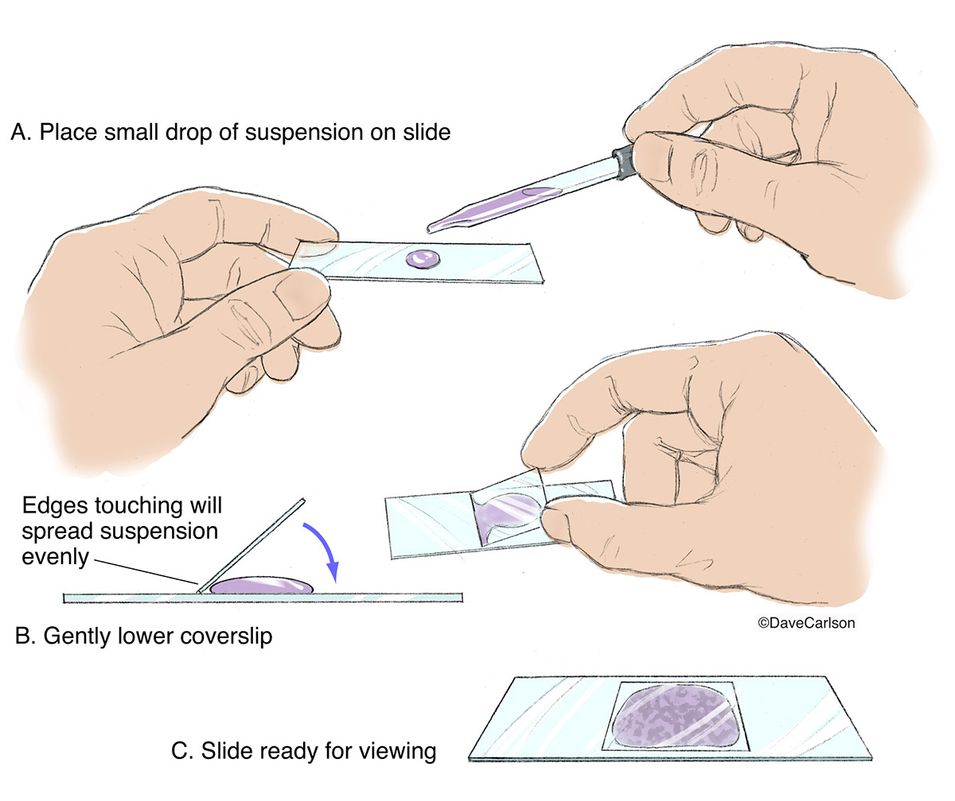
How to make a wet mount
Obtain glass slides
Collect plant samples!
Place drop of water on slide
Place sample on slide
Lower cover glass slowly to avoid air pockets
Can use paper towel to absorb excess water
Useful for looking at samples straight from the field

Slide 3
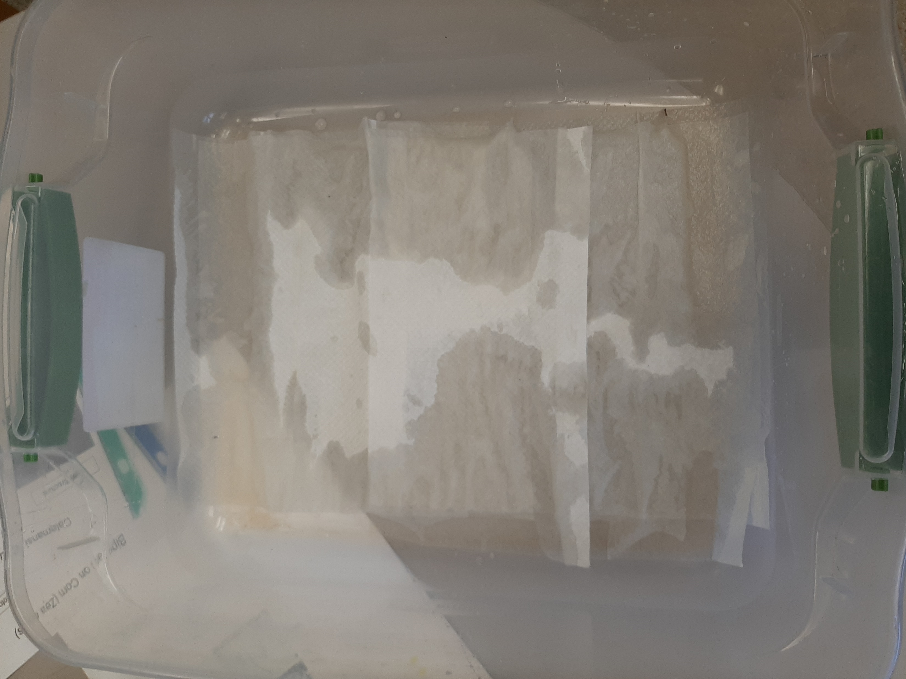
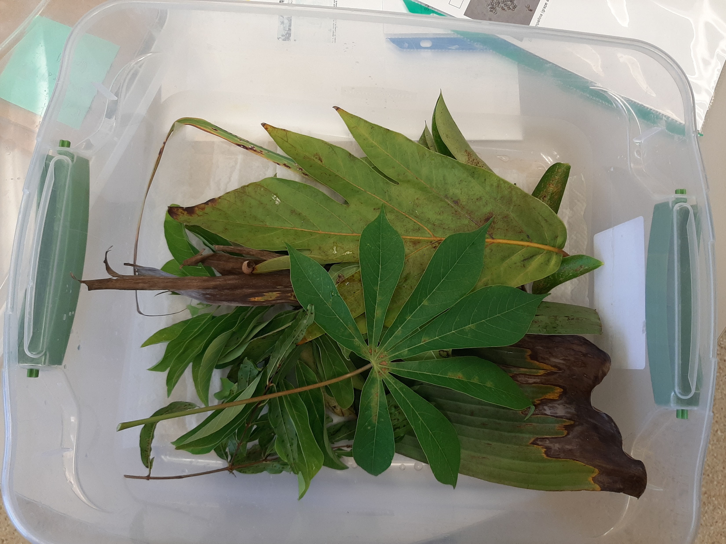
How to make a moisture chamber
Find a suitable container to place samples
Add damp paper towels to the base
Collect plant samples!
Creates an environment with 100% RH
Check back later for fungal growth

