Slide 1
Creating Tutorials
Kisha L. Shelton, PhD
Dept of Plant Pathology

Slide 2
What is a Tutorial? (in Education)
A method of transferring knowledge
Can be used as a part of the learning process
Tends to be more interactive and specific than a lecture, notes, or a book
Usually depends on an example of an activity
Supplies the information needed to complete a certain task

Slide 3
Tutorials can be written or video
Written Tutorials
Video Tutorials
Easy to follow
Think long-from technical narrative
Combination of words and images
Each step is represented by an image to provide some visual clarity
Clear and concise to avoid confusion
Organized detailed directions to complete a task
Broken down into small steps
Often has a FAQ section
Recorded (live action) technical narrative or Converted Powerpoint
Can use written text in places
Each step is carried out
Depending on the type of tutorial you might have to employ “cooking show techniques”
Inform, instruct, challenge, engage and invoke
Supplemental to a class lecture or written material (notes)
Keep them short

Slide 4
Why create a tutorial?
How many of you have googled how to …..
Cook a dish
thaw a turkey for a holiday meal
use something on your phone
use a smartwatch
do a statistical analysis
fix your printer or computer
Lose those last 5lbs
Change a flat tire
People on various platforms (Youtube, TikTok, even Facebook) are looking for How To Type Videos….In fact up to 30% of people searching on Youtube are looking for How To videos (https://truefocusmedia.com/5-reasons-why-you-should-be-creating-how-to-videos/)
It is a way for you to connect with the public
It is a way to get a message out
Increases public literacy about your topic

Slide 5
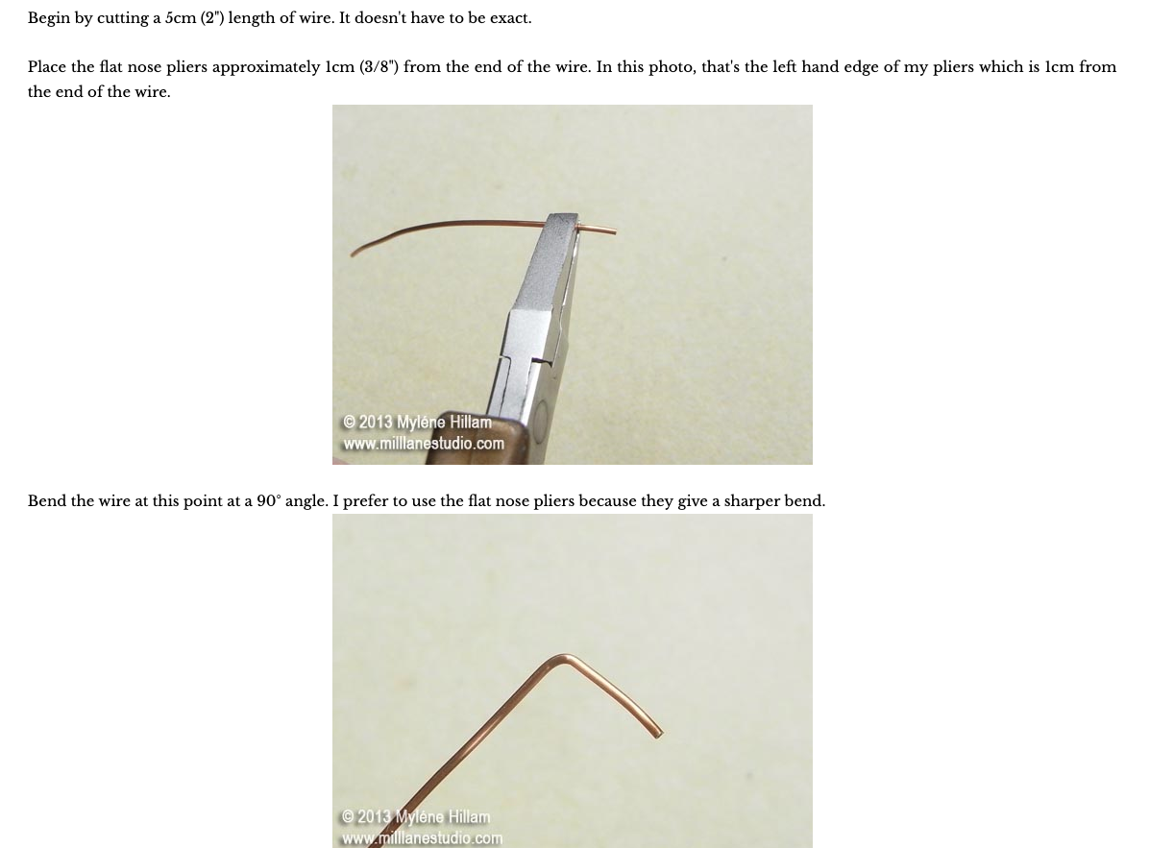
Examples of Written Tutorials (found online)
https://www.wikihow.com/Write-a-Tutorial
A Crafting example https://blog.milllanestudio.com/2013/05/jewellery-know-how-eye-pin-loops-glue.html

Slide 6
Examples of Video Tutorials (not all science related)
https://www.youtube.com/watch?v=MeqnsnYz2Ks&t=23s
UGA Rutherford Hall Compost Tumbler Tutorial
https://www.youtube.com/watch?v=LVK8qsfHrRs&t=88s
How to grow Lychee plant from seeds - how to germinate Lychee seeds
https://www.youtube.com/watch?v=QqjoYwSMYvk
How to Paint a Cow in Watercolour - A step-by-step guide

Slide 7
Benefits of Video Tutorials (educators)
Saves money and resources
Video is flexible (you can customize it)
Engagement with learner
Increased information retention*
Learners develop trust after understanding the steps involved in a service or process.
You can train on-demand (Don’t have to wait for special training workshops for new employees, students, etc)
Increase your audience reach
  Video can be used anytime, anywhere, they can be very accessible, shared easily
Can boost work productivity
A study shows (by Forrester research https://www.panopto.com/blog/5-facts-you-can-use-to-make-the-case-for-video-in-your-learning-development-organization/
+75% employees are more likely to watch a video than read text
The Average employee forgets 65% of material in a standard training after 7 days, after six months they have forgotten 90%.
Adding video can improve people’s ability to remember concepts and details.

Slide 8
Things to Consider….The Who, Why, What, How, etc
Identify the learning goals
Have a plan (storyboarding)
Tell a story (beginning, middle and end)
Know your audience (school age, college age, adults, newbies to the subject or experts)
Be sure to tie things together…..think full circle.
Video length, short and sweet, humans have short attention spans
Start simple
What platform will you use to upload the video

Slide 9
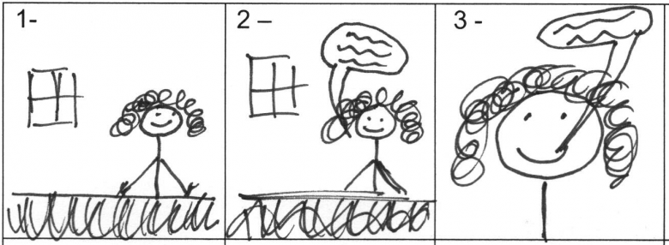
What is a StoryBoard
A tool for sketching out how a video will unfold, shot by shot
Looks like a comic strip, each square represents a single shot
Includes scene layout, materials needed, people involved in scene, the script, any text or graphics that appear on screen

Slide 10
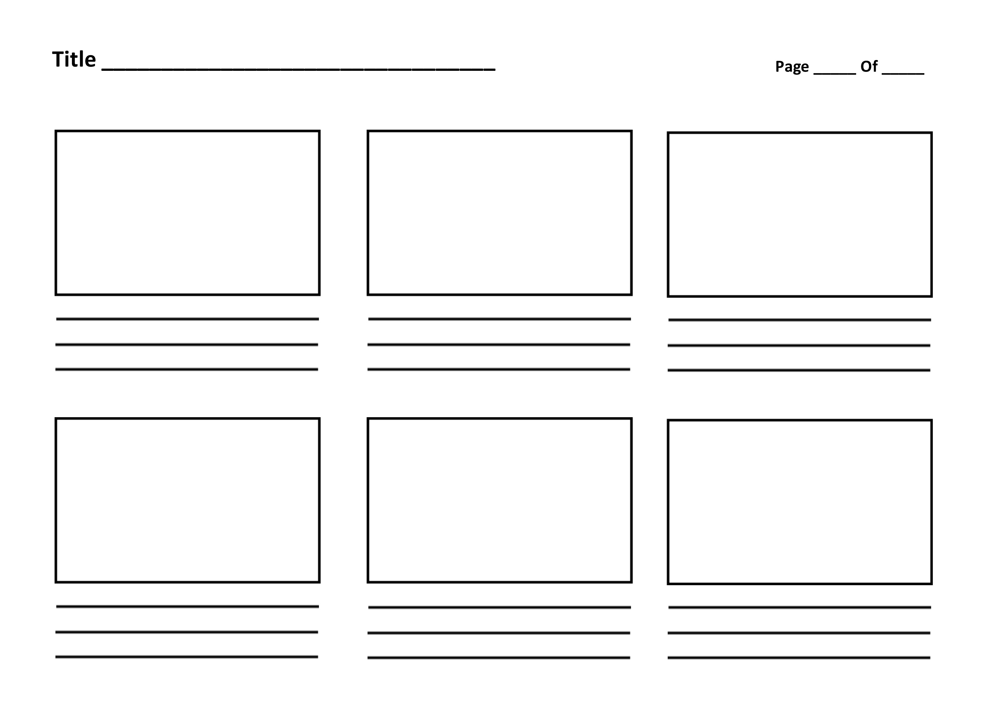
An Example of a Storyboard

Slide 11
Steps for Creating a Storyboard
Establish a timeline---essentially create the structure
Identify key scenes and sketch out (you don’t have to be an artist)
Decide how much detail to add to each scene (don’t overwhelm your audience with extra material that doesn’t matter)
Write your script (what will you say). Will it be live dialogue or will you add a voiceover?
Once you have become a video master, you can consider using “cuts”—zooming in or zooming out to highlight things.

Slide 12
Where can you post your video
Youtube –free video sharing website. Can create and upload videos to share. Up to to 15 mintues long, verified accounts can load longer videos
Facebook– social media platform….if your group has a webpage for outreach….great place to share videos for training (not larger that 10GB and less than 240 minutes long)
Instagram—upload videos that are short…..think 60 seconds.
TikTok– can record the video and make final edits, add caption to the video and upload that video all in TikTok.
FYI: Some of these platforms can be linked…..
For example, post in Instagram and it will automatically share the post to a Facebook page you have linked.

Slide 13
Supported Video Formats for Media Platforms
YouTube
.MOV
.MPEG-1
.MPEG-2
.MPEG4
.MP4
.MPG
.AVI
.WMV
.MPEGPS
.FLV
3GPP
WebM
DNxHR
ProRes
CineForm
HEVC (h265)
Facebook
3g2 (Mobile Video).
3gp (Mobile Video).
3gpp (Mobile Video).
asf (Windows Media Video).
avi (AVI Video).
dat (MPEG Video).
divx (DIVX Video).
dv (DV Video).
f4v (Flash Video).
flv (Flash Video).
gif (Graphics Interchange Format).
m2ts (M2TS Video).
m4v (MPEG-4 Video).
mkv (Matroska Format).
mod (MOD Video).
mov (QuickTime Movie).
mp4 (MPEG-4 Video).
mpe (MPEG Video).
mpeg (MPEG Video).
mpeg4 (MPEG-4 Video).
mpg (MPEG Video).
mts (AVCHD Video).
nsv (Nullsoft Video).
ogm (Ogg Media Format).
ogv (Ogg Video Format).
qt (QuickTime Movie).
tod (TOD Video).
ts (MPEG Transport Stream).
vob (DVD Video).
wmv (Windows Media Video).
Instagram
.MOV
.MP4

Slide 14
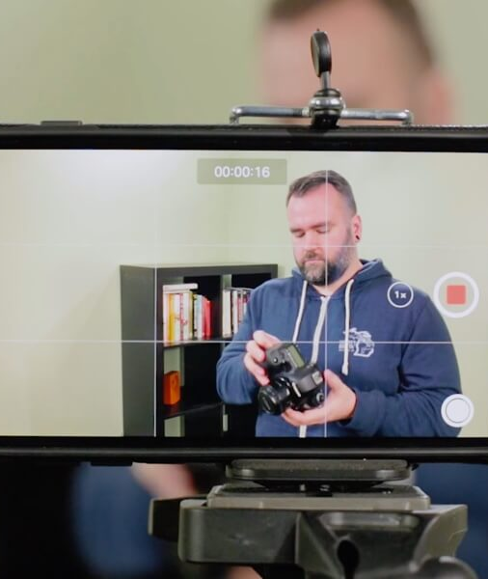
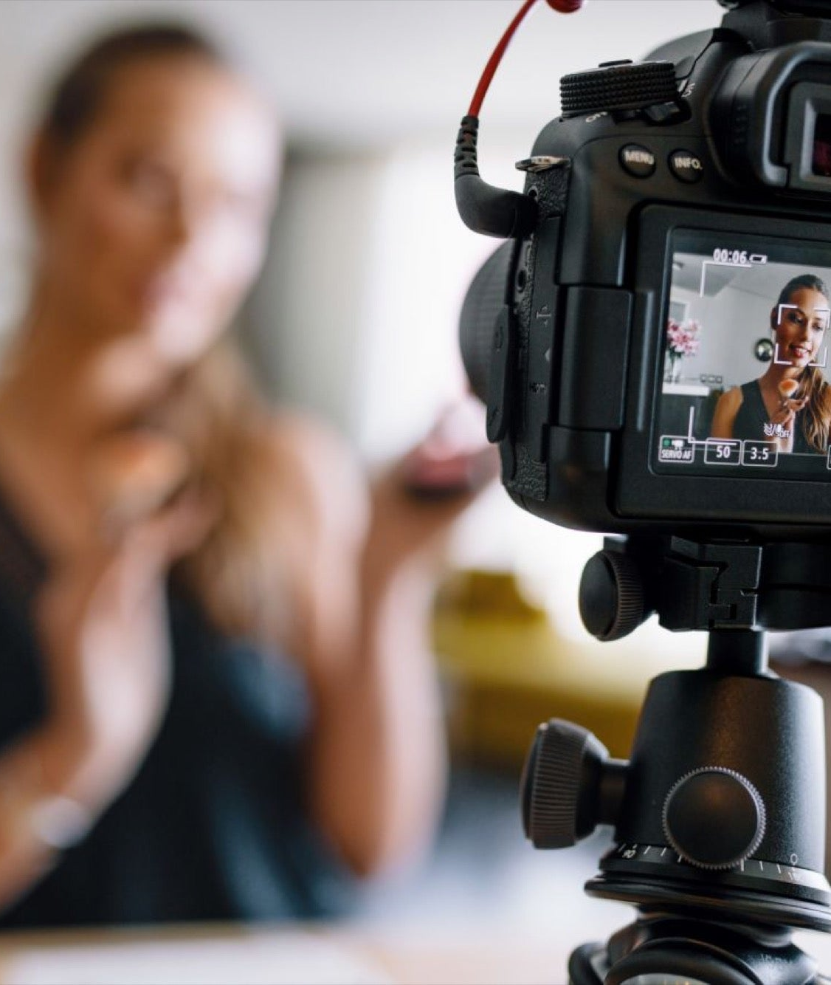


Equipment
Cameras
  Smartphone
  DSLR
  Go Pro
Lighting
  Various kinds of lighting available
Tripod and Mounts for stabilization
  Even Selfie-sticks
Laptops with software
  Powerpoints
  Video editing software (Macs have iMovie)
Microphones
Notes:
Left-aligned multi-photo template. To replace the photos above, select the current photo, right-click and choose “change picture.” Your photo can then be cropped and moved by right-clicking and selecting “crop.”

Slide 15
What is a Tutorial? (in Education)
A method of transferring knowledge
Can be used as a part of the learning process
Tends to be more interactive and specific than a lecture, notes, or a book
Usually depends on an example of an activity
Supplies the information needed to complete a certain task

Slide 16

How to Upload to YouTube:
1. Log in to your YouTube account.
2. Open the YouTube homepage.
3. Click on the “Sign In” button at the top right-hand corner of the page.
4. Sign in using your YouTube, Google, or Google+ details.
5. Click the “Create a Video or Post” icon. This is also located on the top right-hand corner of the page.
6. Click the upload button that’s located on the top of the homepage to the right of the search bar.
7. Choose the video you want to upload.
Go to “Select Files To Upload” to open the browser, then find the file you want to add. Alternatively, you could drag and drop your video into the browser window. But wait…BEFORE you click the open button, you will need to choose your video’s privacy settings first.
8. Before uploading your file, you will need to choose your privacy settings from the center drop-down menu where four different options will appear.
9. Now click on the open button.
10. Next, you will need to add your YouTube video details.
  You can do this by clicking on your profile icon in the top right-hand corner of the page. Then from the drop-down menu that appears, select “Switch Accounts.” It will now show you all the logged in accounts so you can choose the right one for your current video upload.
11. Lastly, you will need to hit “Save”.
For more information: https://support.google.com/youtube/answer/57407?hl=en&co=GENIE.Platform%3DDesktop
Notes:
Half page photo template. To replace the photo above, select the current photo, right-click and choose “change picture.” Your photo can then be cropped and moved by right-clicking and selecting “crop.”

Slide 17
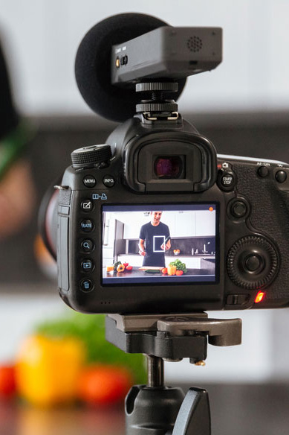
Resources:
Basic Steps to Making a Science Video with a Smartphone
https://www.youtube.com/watch?v=j7YIGEAwb_E&t=177s
The Complete Instagram Video Size Guide for 2021 (+6 Video Tools to Try)
https://influencermarketinghub.com/instagram-video-size/
How do I post a video on Facebook?
https://www.facebook.com/help/166707406722029/
Cameras with a tripod……
Notes:
Half page photo template. To replace the photo above, select the current photo, right-click and choose “change picture.” Your photo can then be cropped and moved by right-clicking and selecting “crop.”

