Slide 1




Lifecycle and ID of Colletotrichum
Marin Talbot Brewer
Dept. Plant Pathology
University of Georgia
August 12, 2021
@marintalbrew
mtbrewer@uga.edu

Slide 2
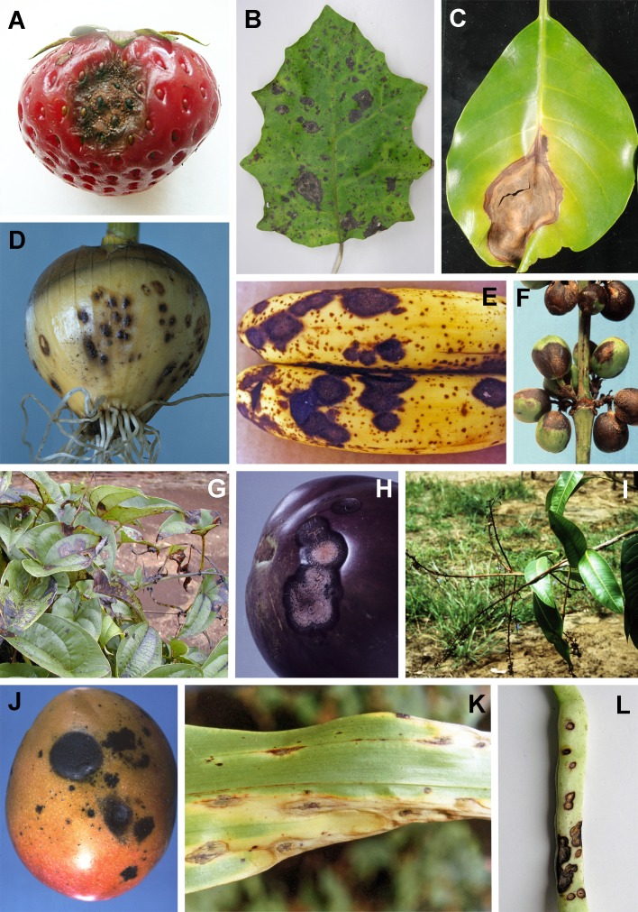
Colletotrichum
Disease symptoms caused by Colletotrichum species
Cause anthracnose diseases
In most cases identified only to species complex level
Notes:
Anthracnose – dark lesions with salmon colored to white mucilaginous masses of spores on foliage fruits and stems
Species complex – morphologically indistinguishable, genetically distinct (DNA sequencing). Usually Doesn’t matter from a practical purpose, akthough differ evolutionarily (fungicide resistance)
Anthracnose on strawberry fruit caused by C. nymphaeae (acutatum clade). B. Leaf spot of Brachyglottis repanda caused by C. beeveri (boninense clade). C. Anthracnose symptoms on leaves of Tecomanthe speciosa caused by C. boninense agg. D. Anthracnose of onion bulb caused by C. circinans (dematium clade). E. Anthracnose of banana caused by C. musae (gloeosporioides clade). F. Coffee berry disease caused by C. kahawae subsp. kahawae (gloeosporioides clade). G. Leaf anthracnose of yam caused by C. gloeosporioides agg. H. Anthracnose of aubergine (eggplant) fruit caused by C. gloeosporioides agg. I. Blossom blight of mango caused by an undetermined Colletotrichum sp. J. Anthracnose of mango caused by C. gloeosporioides agg. K. Leaf blight of maize caused by C. graminicola (graminicola clade). L. Anthracnose of bean pod caused by C. lindemuthianum (orbiculare agg.). A
Fruit production is especially affected, both high-value crops in temperate markets such as strawberry, mango, citrus and avocado, and staple crops such as banana. Colletotrichum species cause devastating disease of coffee berries in Africa, and seriously affect cereals including maize, sugar cane and sorghum. The genus was recently voted the eighth most important group of plant pathogenic fungi in the world, based on perceived scientific and economic importance (Dean et al. 2012).

Slide 3
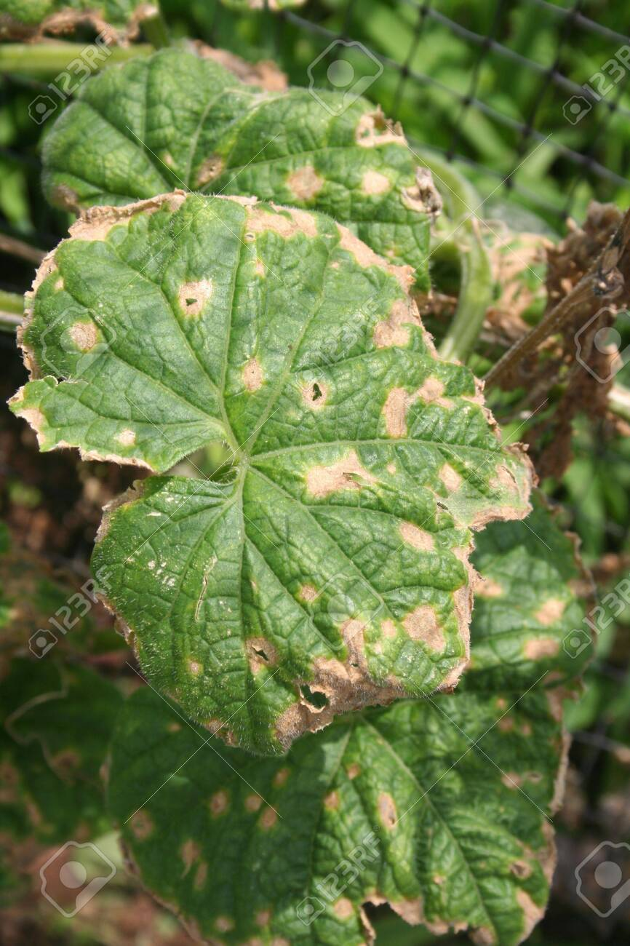
Colletotrichum hosts on Guam
Severe anthracnose on:
  Papaya
  Cucumber
  Mango
Also causes foliar symptoms on 50 other crops and ornamentals
  breadfruit, avocado, banana, eggplant, pepper, yam, watermelon, tomato, mango
  plumeria, bougainvillea, dracaena, croton

Slide 4
The genus Colletotrichum
It has a primarily tropical and subtropical distribution
Mostly asexual (conidia) but some also reproduce sexually (ascospores)
Hemibiotrophs and endophytes
Notes:
The biotrophic life strategies adopted by Colletotrichum species may also contribute to their prominence as symptomless endophytes of living plant tissues
Nascent colonies in most cases then enter a biotrophic phase with infected tissues remaining externally symptomless and which may be short (1–3 d; O’Connell et al. 2000) or extended and presumably involving dormancy (Prusky & Plumbley 1992). Then, the fungus enters a necrotrophic phase that results in significant death of plant cells and the emergence of pathogenic lesions. This delayed onset of disease symptoms may lead to significant post-harvest losses, with apparently healthy crops degenerating in storage (Prusky & Plumbley 1992). The biotrophic life strategies adopted by Colletotrichum species may also contribute to their prominence as symptomless endophytes of living plant tissues (Lu et al. 2004, Joshee et al. 2009, Rojas et al. 2010, Yuan et al. 2011).

Slide 5
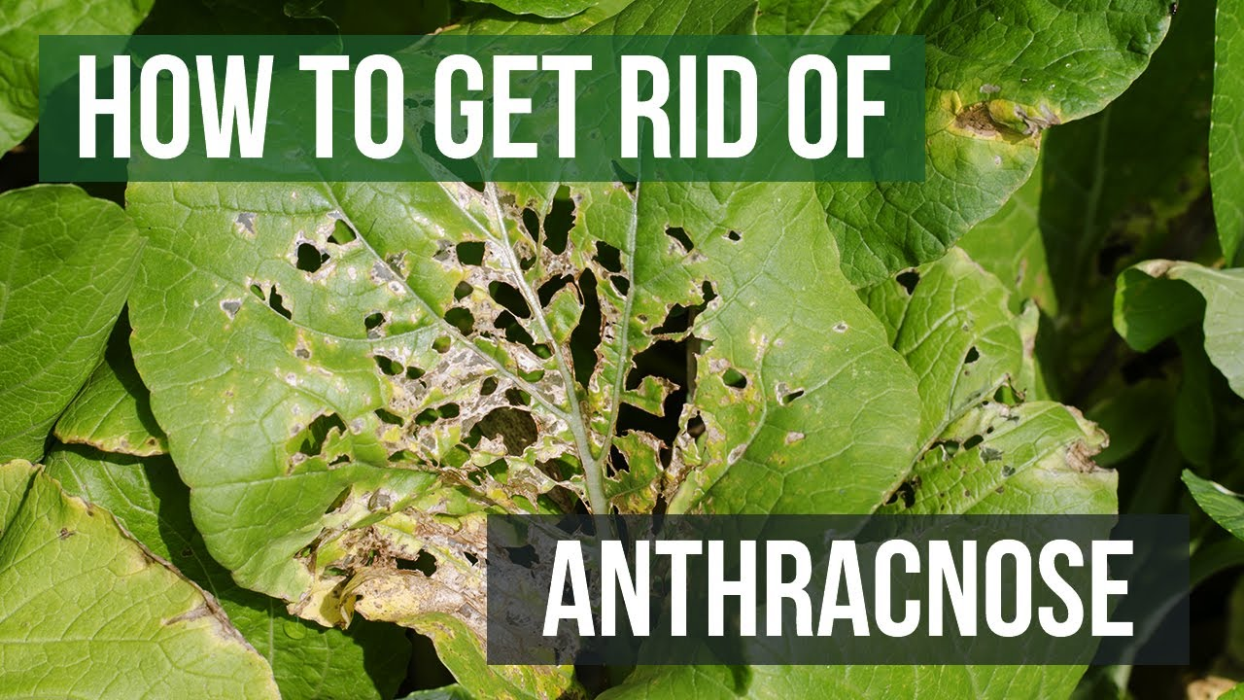
Anthracnose
  Seed transmitted
  Saprophyte in soil
  Spread by
    Cucumber beetles
    Water splash
    Workers/tools
  Control
    Disease-free seed
    Crop rotation
    Resistant cultivars
    Arthropod control
    Sanitation
    Chemicals
Notes:
burning infected crops and careful control of weeds.

Slide 6
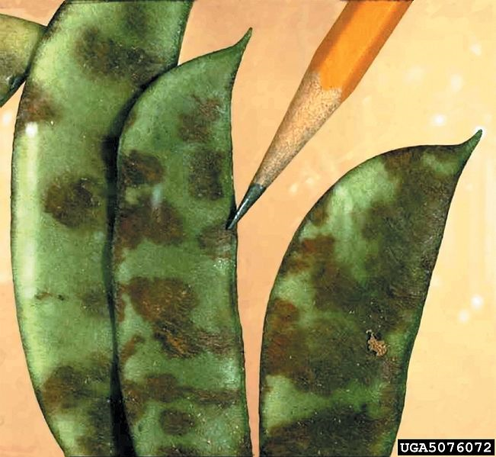
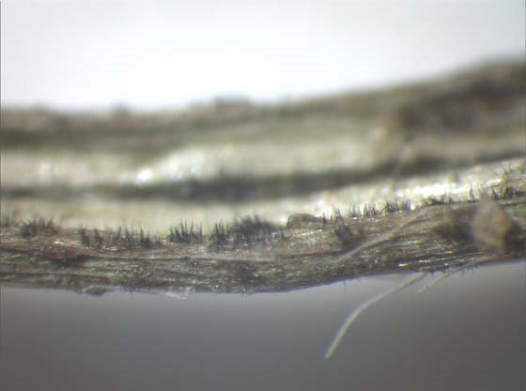
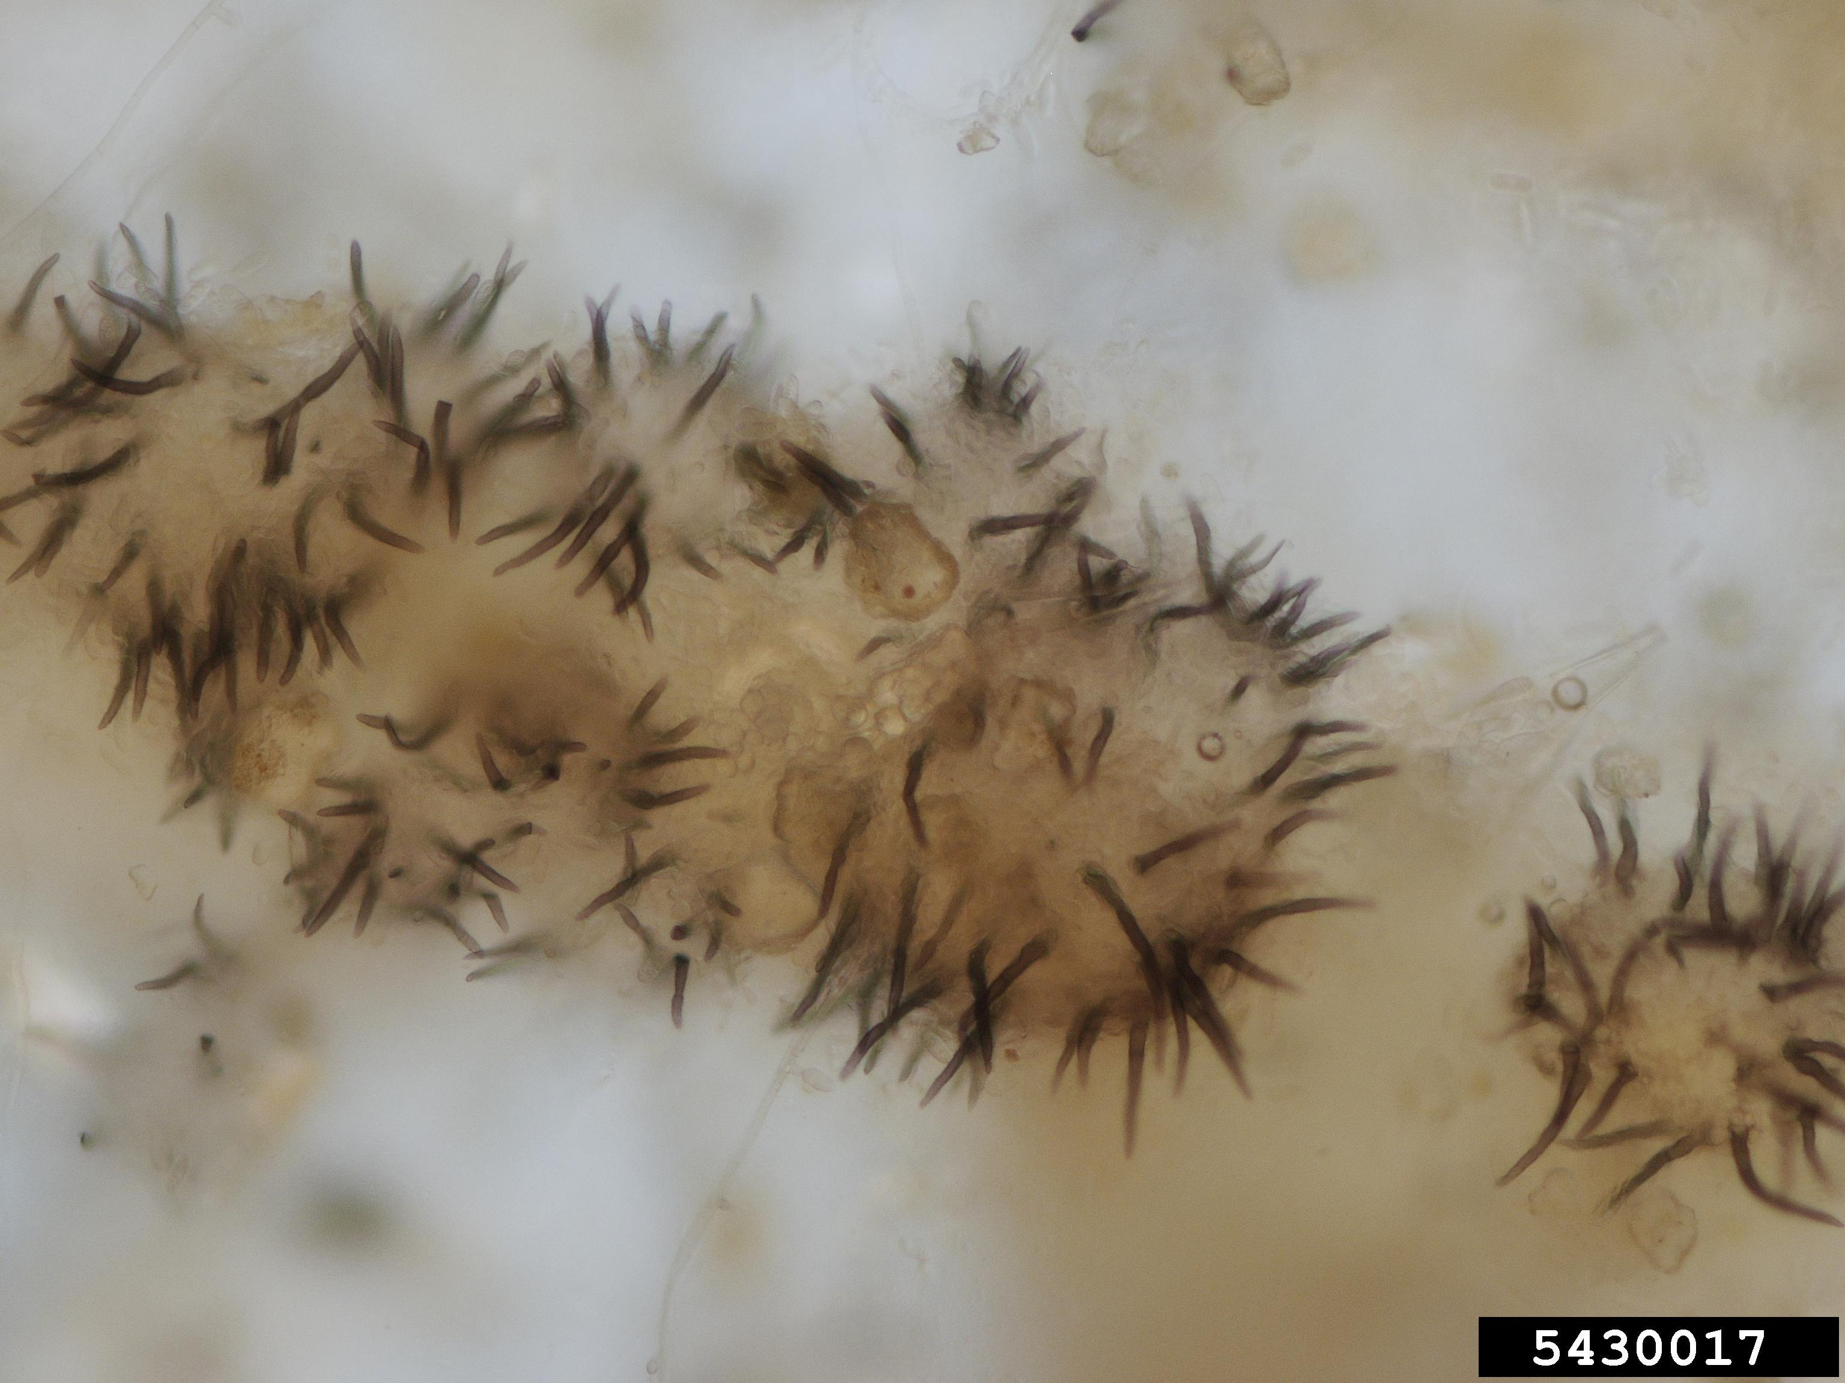
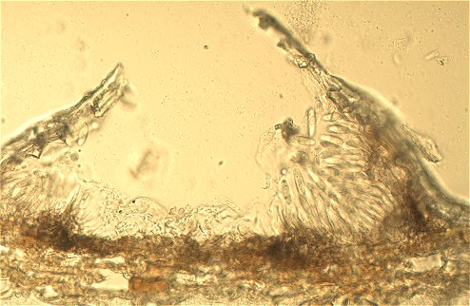
Acervuli (-us)
Setae
Notes:
acervulus (pl. acervuli) - a small, cushion-shaped structure erupting through the epidermis of plants
Bean
Setae – dark, pointed thick-walled modified hyphae
C. Orbiculare Cuccumber on the right
Dissecting scope

Slide 7
Colletotrichum species complexes on Guam
C. obiculare
C. gloeosporioides
Notes:
Identified by molecular ID
Nine species in complex

Slide 8

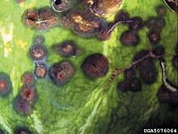
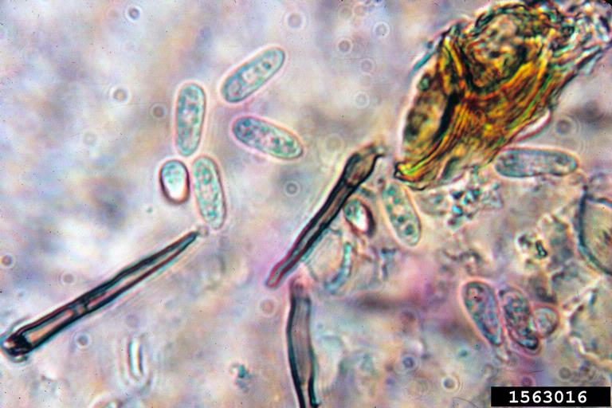
Colletotrichum obiculare
  nine species in species complex
  melons and cucumber
  lesions have shot-hole appearance
Notes:
Identified by molecular ID
Nine species in complex

Slide 9
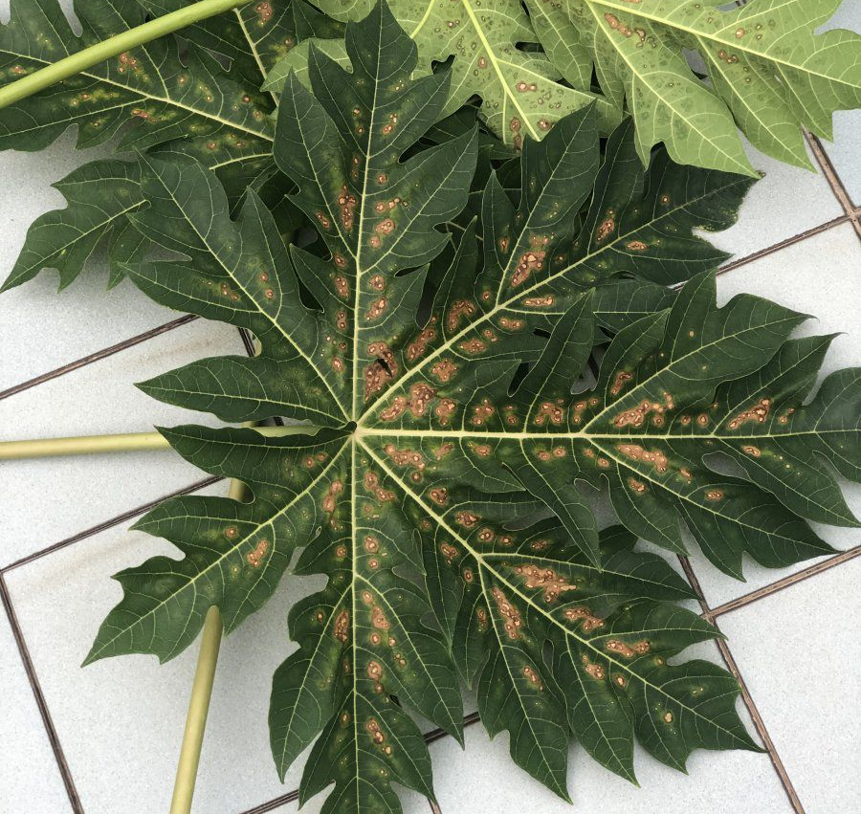
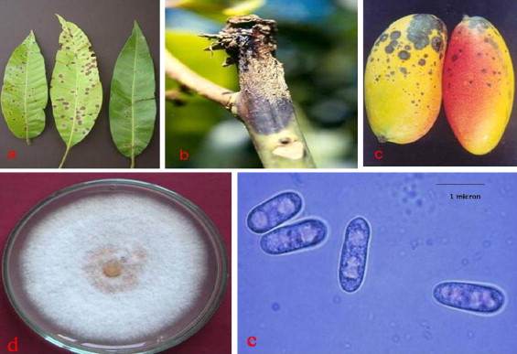
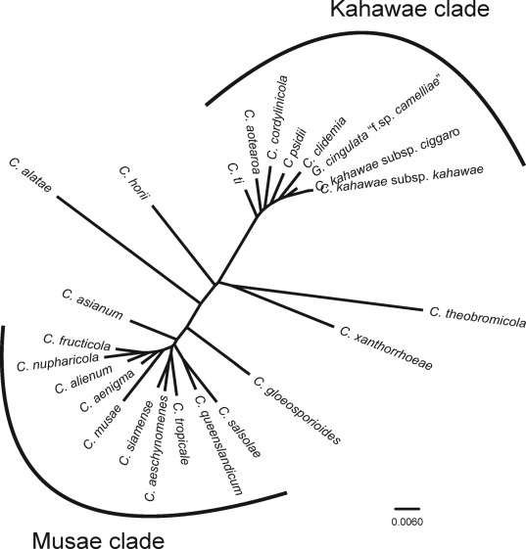
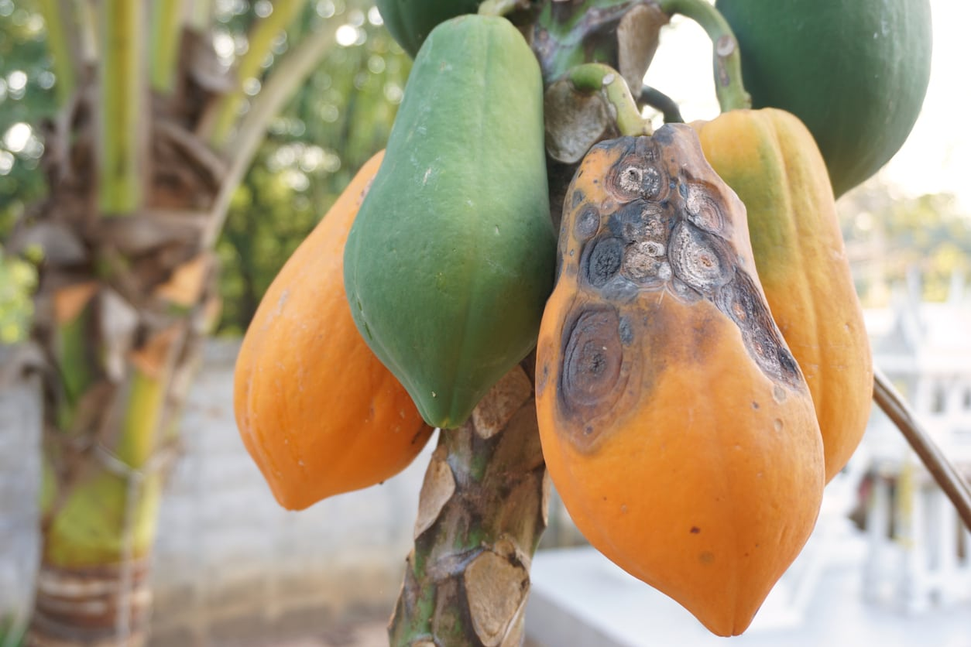
Colletotrichum gloeosporioides
  22 species in species complex
  Very broad host range
  Papaya most affected on Guam
  Glomerella cingulata sexual state name
Notes:
Seen here on mango
22 species in the species complex

Slide 10
General Lifecycle of Colletotrichum
Notes:
Not all have sexual state

Slide 11
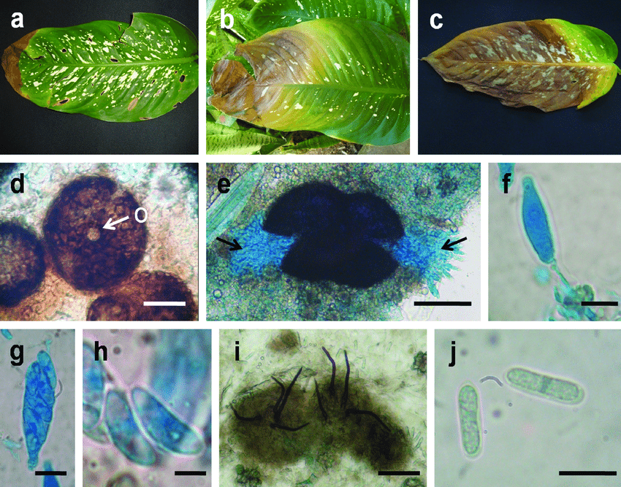
Sexual and asexual structures
Colletotrichum gloeosporioides
(syn. Glomerella cingulata)
Notes:
Ornamental and houseplant
a-c. Dieffenbachia seguine showing leaf spot starting from the edges. d. Perithecium of Glomerella cingulata showing ostiolar opening (o, arrow). e. Hymenium seen from lateral fissure of Perithecia of G. cingulata. f. Young ascus colored with cotton blue. g. Mature ascus. h. Ascospores. i. Acervular conidioma of anamorph (Colletotrichum gloeosporioides) showing straight or flexuous setae. j. Conidia. Bars: d, i = 50 µm; e = 100 µm; f, h = 5 µm; g, j = 10 µm. Photos: M.E. Caliman and Jad. Pereira.

