Slide 1




Collecting, processing and sending samples off-island for ID
Marin Talbot Brewer
August 11, 2021
@marintalbrew
mtbrewer@uga.edu

Slide 2
Collecting foliar samples
Take photos of symptoms and signs in the field.
Record host information (species and variety, if known), place and date of collection (photos below). If possible, also include GPS locations.
Collect 5 to 20 leaves showing signs/symptoms
Keep leaves at room temperature with some humidity (damp paper towel) if unable to ship immediately. May need to refrigerate (condensation problems?)

Slide 3
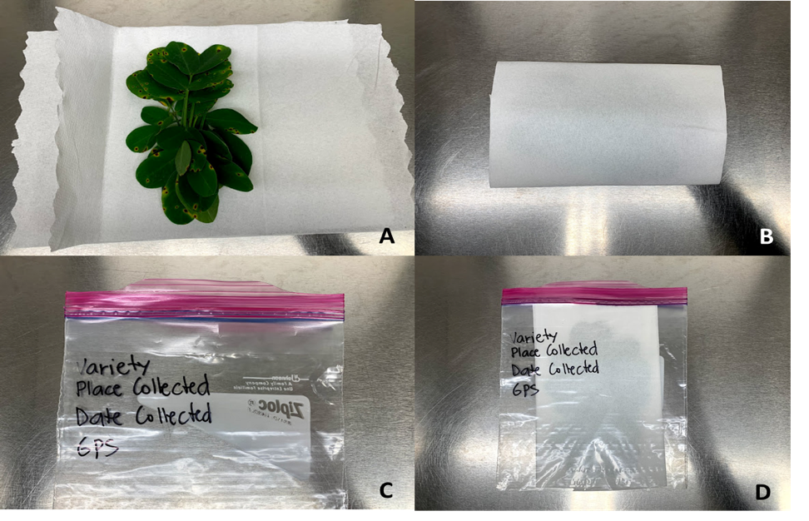
Processing samples
Wrap collected leaves with dry paper towels. Then put them in Ziploc bags or plastic bags tied in a knot.
Before wrapping the leaves make sure they are not moist and there is no soil or dust on them.
May have to modify a bit depending on
leaf thickness, thickness of cuticle layer,
etc.
Ship as soon as possible but Mondays
or Tuesdays are preferable.

Slide 4
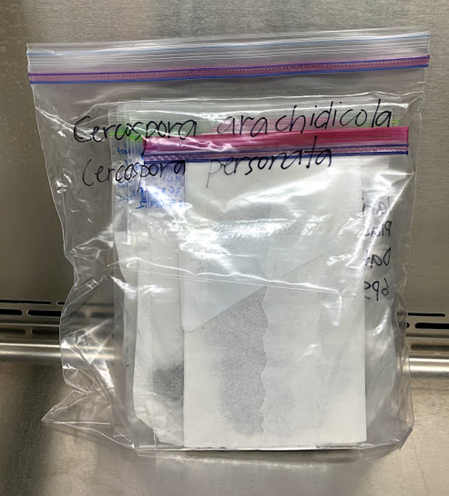
Sending samples
Place the bags in another plastic bag tied with a knot or in another Ziploc bag labeled with full name of organism to prevent any leakage or escape.
Place the bag in a sturdy box, enclose the APHIS permit of the recipient and tape the box closed.
Attach a UPS, FedEx or DHL shipping form. The address on the box must be the same as the address on the permit.

Slide 5
APHIS permit

Slide 6
Where do I send the samples?
Reach out to diagnostic (or research) labs in advance to make arrangements for ID.
https://www.npdn.org/wpdn/public_contacts
The lab must have a permit to receive samples from US Territories, Guam, or Hawaii and Pacific Territories.
Attach a UPS, FedEx or DHL shipping form. The address on the box must be the same as the address on the permit.

