Slide 1
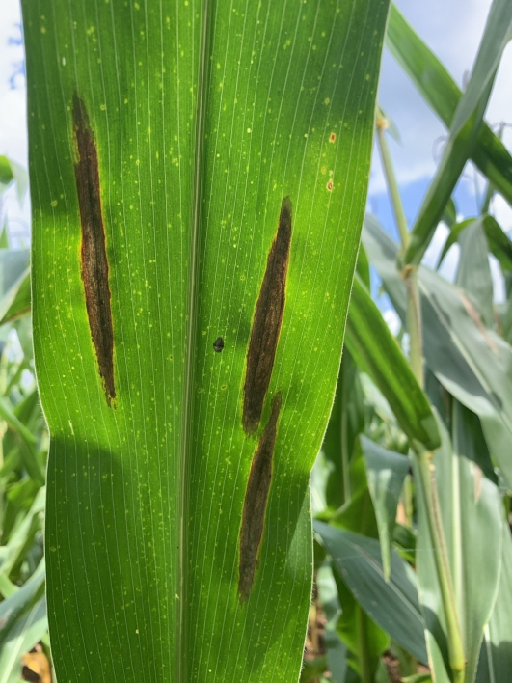
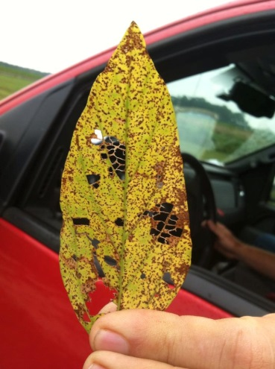
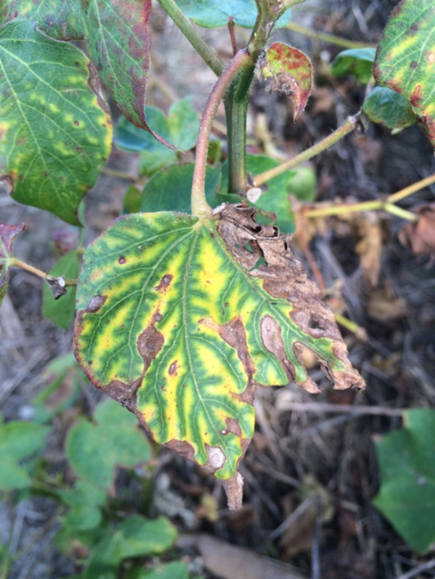
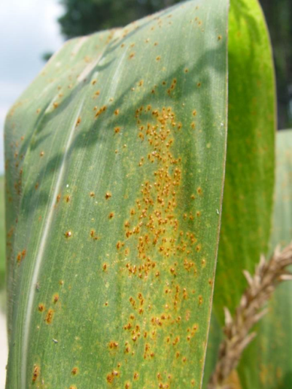
Training for Agricultural Professionals in Guam and the Northern Mariana Islands on identification of prevalent fungal leaf pathogens and their diseases
Robert C. Kemerait Jr., PhD
Professor and Extension Specialist
Department of Plant Pathology
University of Georgia CAES
Follow on Twitter “bob kemerait”

Slide 2
Collecting, Processing, and Storing Field Samples for On-Site Processing and ID

Slide 4
PLANT SYMPTOMS AND SPECIMEN SELECTION
Wilting, yellowing or general decline. If practical, it is best to send entire plant (leaves, stems, roots). Collect plants which have early disease symptoms. Dig up carefully. DO NOT PULL UP---many roots will be lost.
Twig and branch blights and cankers. Select specimens which show recent infection. Include healthy tissues with diseased tissues. DO NOT INCLUDE TWIGS, ETC. WHICH HAVE BEEN DEAD FOR SEVERAL MONTHS. THIS TYPE MATERIAL WILL NOT ALLOW PROPER IDENTIFICATION.

Slide 5
PLANT SYMPTOMS AND SPECIMEN SELECTION
Foliage Diseases. Select leaves which have early and recent infections. Marginal burning of leaves should be sent. Symptoms of this type usually indicate chemical injury or some type of root disorder (physiological, organic or chemical).
Fruit and Fleshy Plant Organs. Diseases of these structures require special attention. Never select a specimen which is exhibiting advanced stages of decay or disease. Select fresh specimens which exhibit early symptoms.

Slide 6
SHIPPING PLANT DISEASE SPECIMENS
Place diseased specimens in a plastic bag.
Do NOT add moisture. Place a DRY paper towel in the plastic bag with the specimen.
Keep samples cool.
Do not allow samples to dry out and desiccate.
Ship specimens Mondays, Tuesdays, Wednesdays. Samples shipped on Thursdays and Fridays usually require longer to reach the Plant Disease Clinic.

Slide 7
Common Issues with Submitted Samples
Samples unattended over the weekend or for extended periods.
Sample sent to the wrong clinic.
No background information provided to aid in diagnosis and recommendations.
Improper packaging that does not protect sample from damage and degradation.

Slide 8
Identification of Fungi
Examine sample
Naked Eye
Dissecting Microscope
Compound Microscope
Induce sporulation/growth
Moisture chamber
Culture media

Slide 9
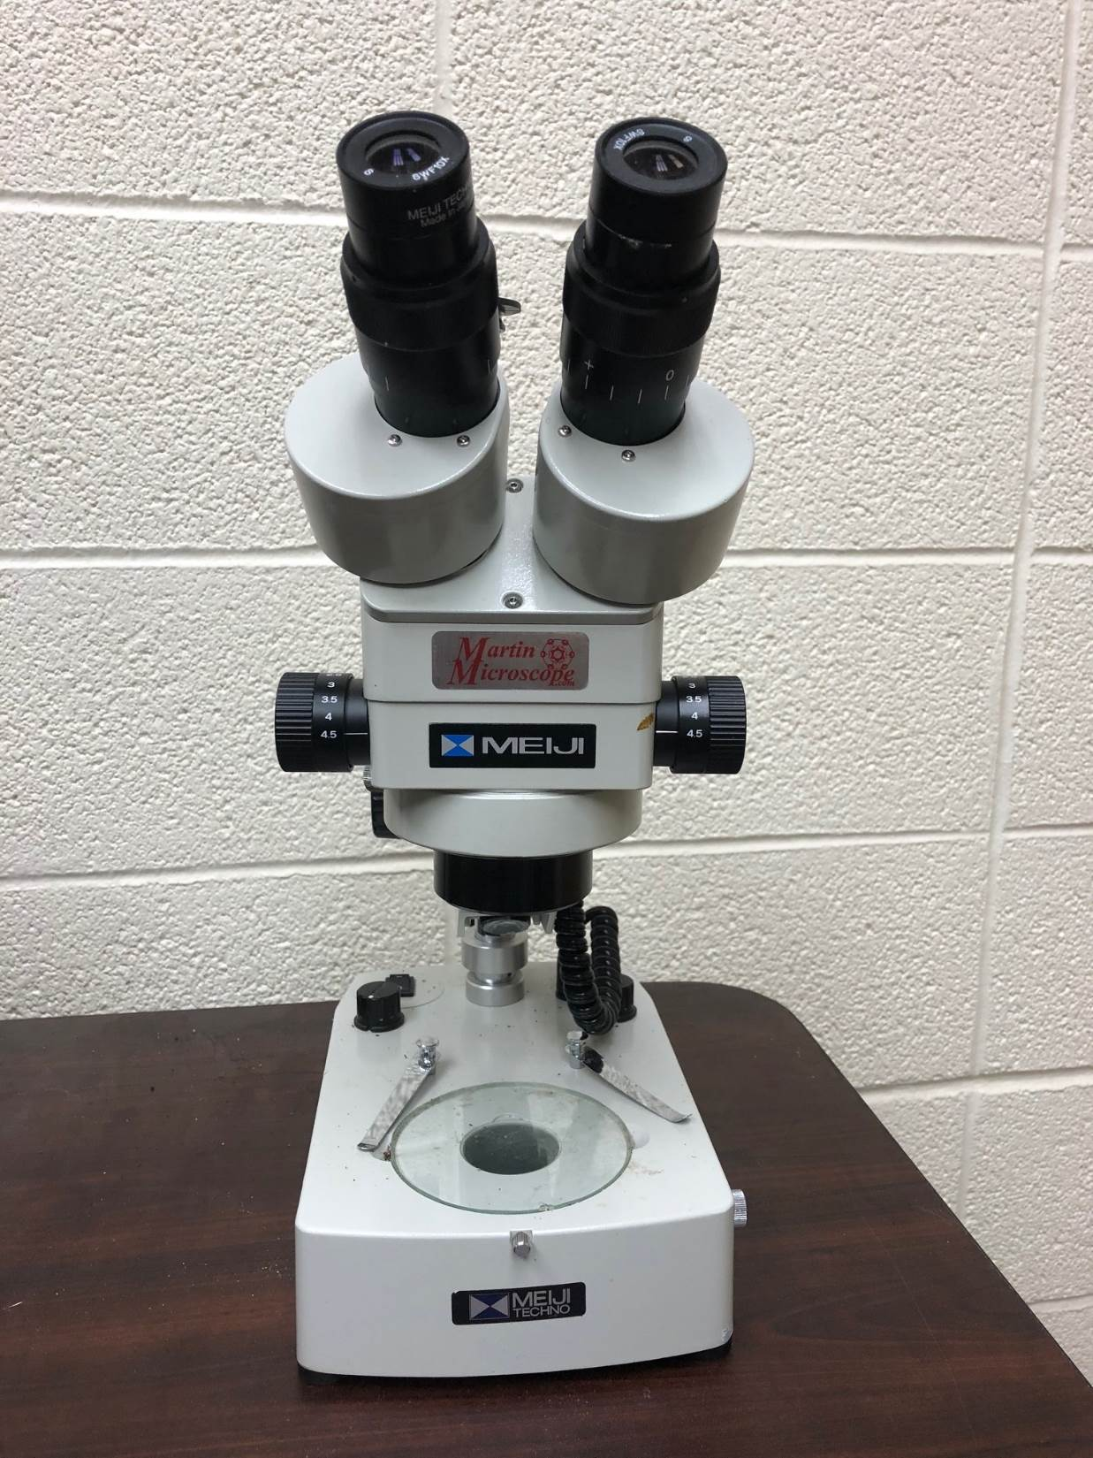
Stereo microscope
10 – 40x

Slide 10
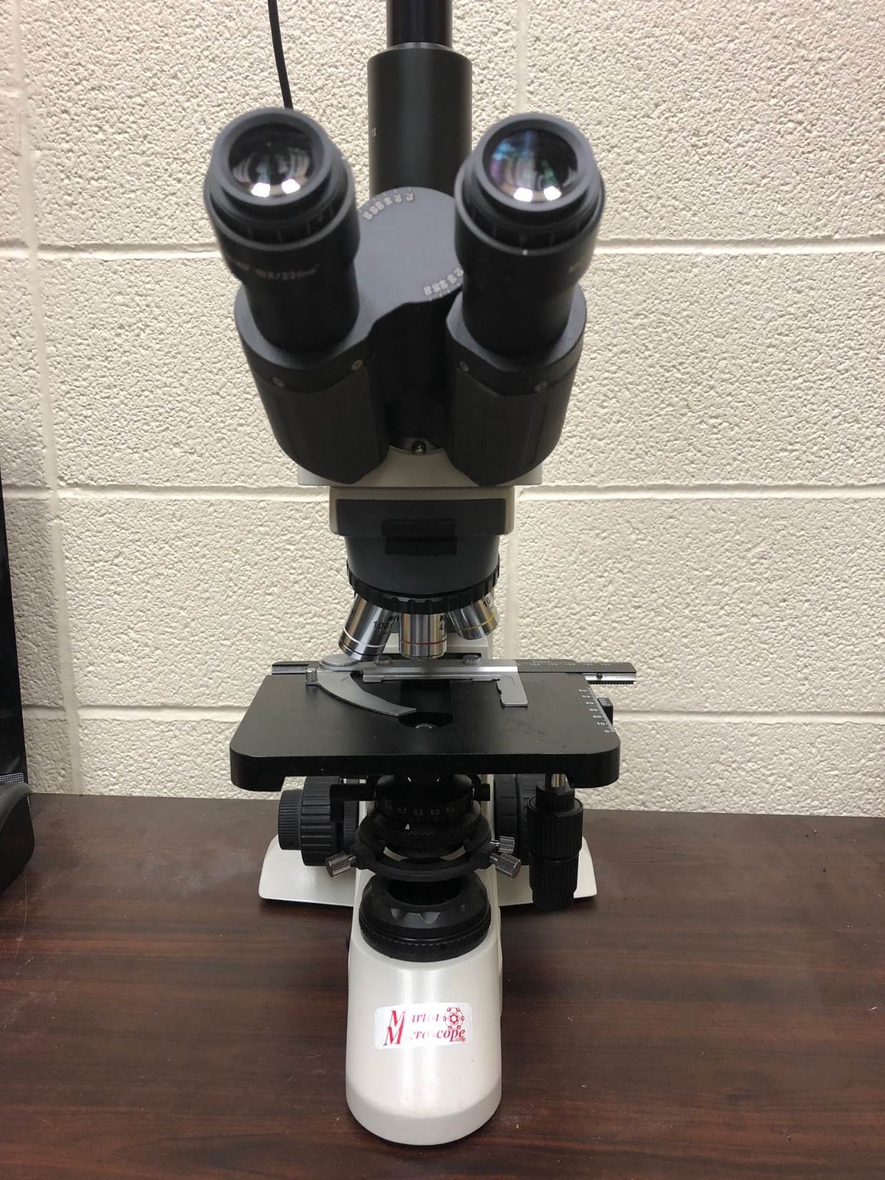
Compound microscope
40 – 1000x

Slide 11
Wet Mount Slide
Place a drop of H₂O on a slide.
Place a small section of plant tissue in the H₂O.
Chop, chop the sample.
Lower a cover slip over the droplet.
Gently apply pressure to the top of the cover slip.
A
B
C
. . .
D
E

Slide 12
Tape Mount Slide
Useful for examining objects on the surface of the plant.
Use clear tape.
Preserves the spore arrangement.

Slide 13
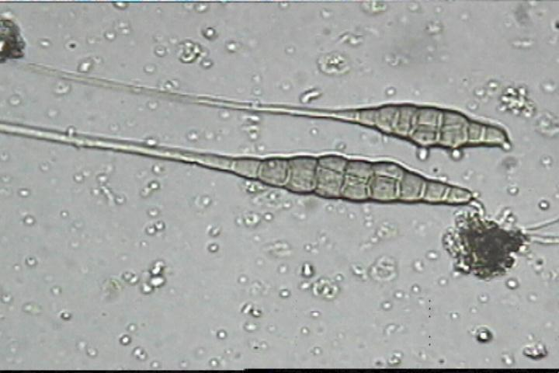
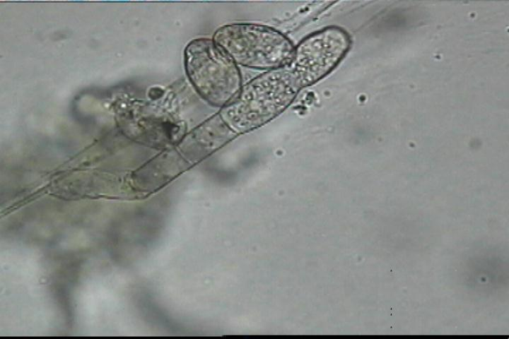
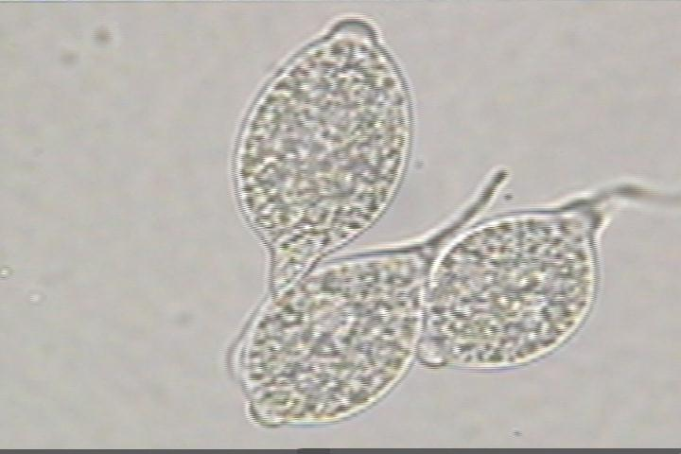

Slide 14
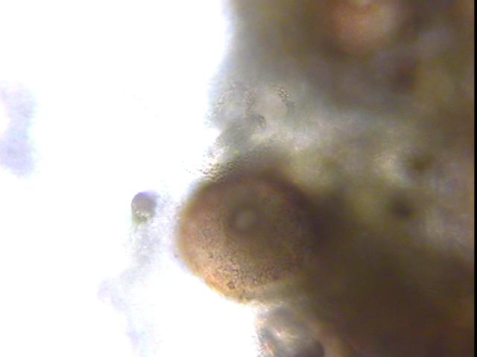
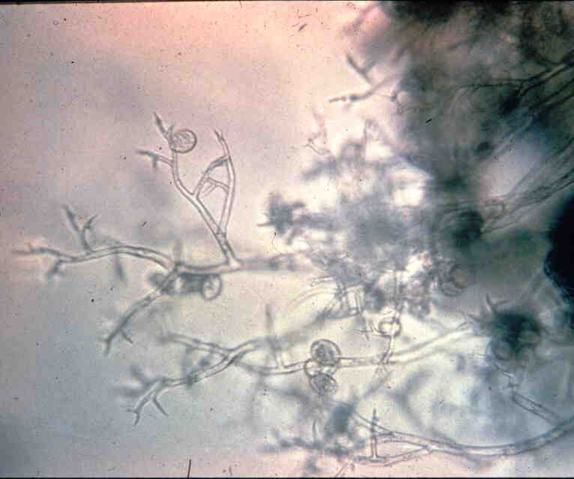
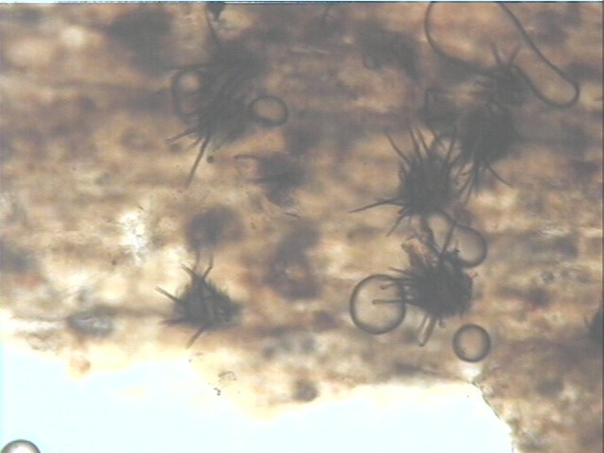

Slide 15
Nutrients
Agar
Water
15 min.
120° C
15 psi
Allow to cool.
Add antibiotics,
Acid, etc.
Work under
a flow hood
Allow to solidify

Slide 16
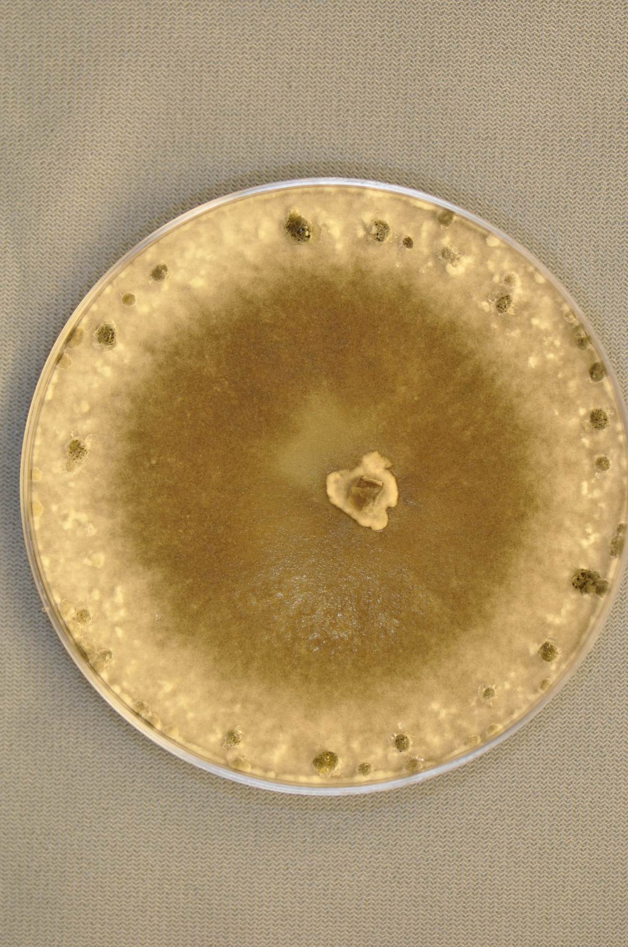
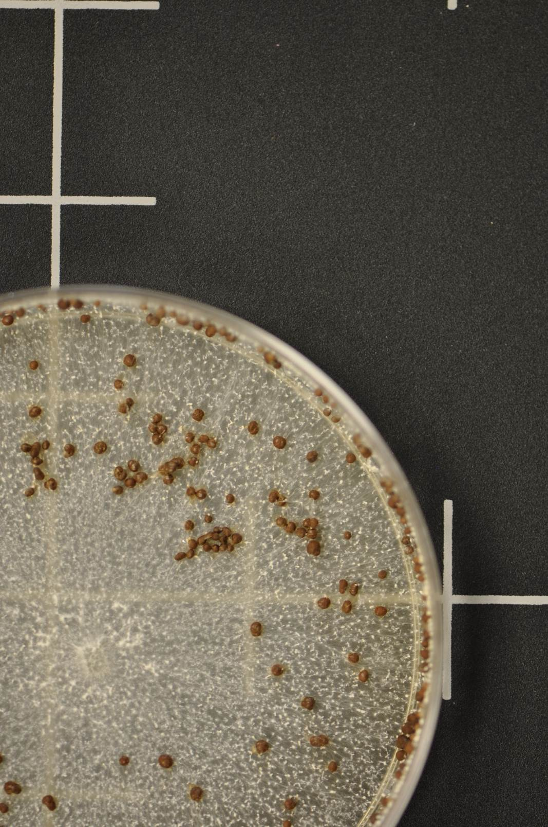

Slide 17
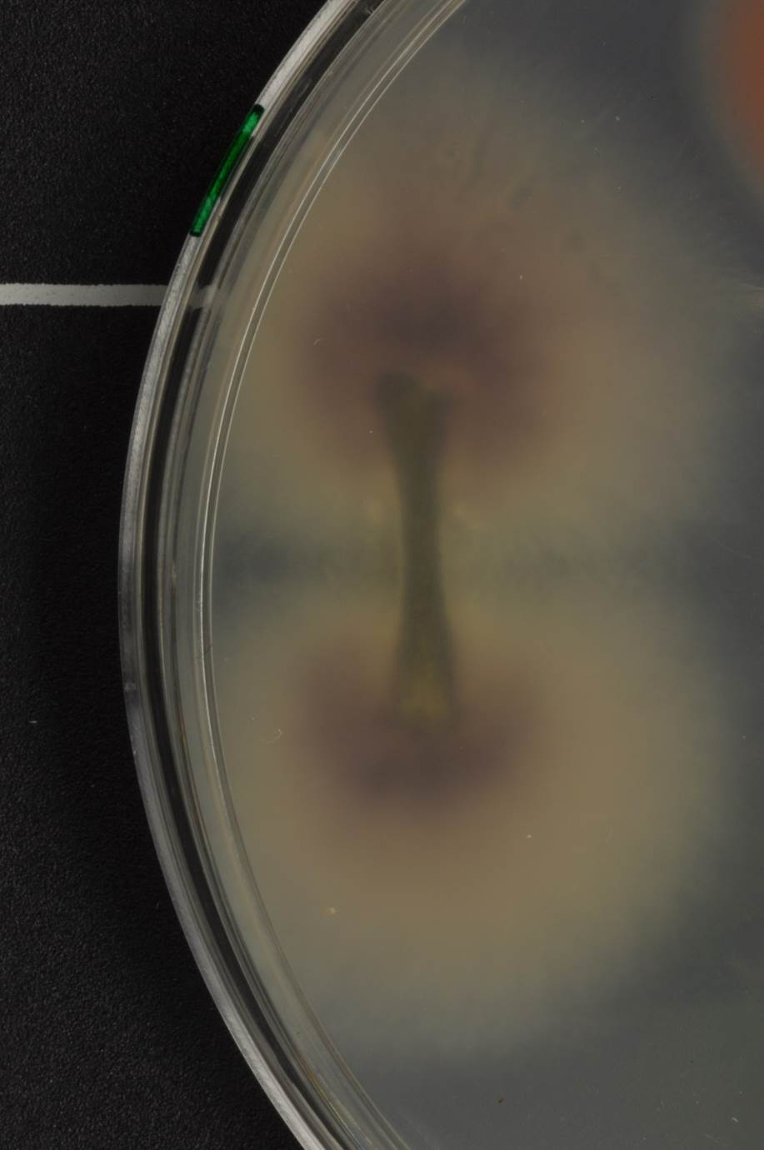

Slide 18
Limitations
Time - some fungi grow relatively slowly.
Secondary organisms.
Pathogen might be present in low numbers.
Certain fungi grow poorly on nutrient media.
Certain fungi sporulate poorly on nutrient media.
Obligate parasites cannot be grown in culture.
Powdery mildew, downy mildew, rusts

Slide 19
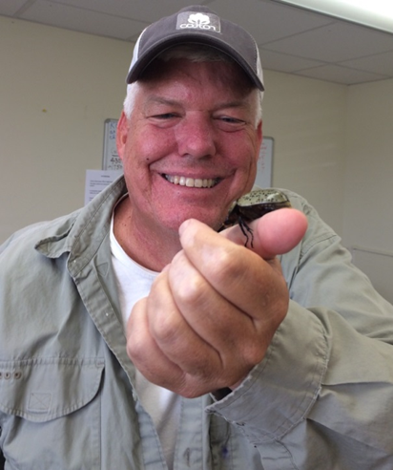
Objectives Throughout My Talks
To facilitate your understanding of basic topics associated with diagnosis of plant diseases caused by fungal pathogens.
To share from my experiences as an Extension plant pathologist to foster discussion and questions.
To learn from you and your experiences working in the Northern Mariana Islands.

Slide 21
Thanks to staff at Attapulgus REC, VALENT USA, and the “Team” QUESTIONS?

