Slide 1
CFS Reversable Close Fitted Mask Project I

Slide 2
Supplies Needed

Slide 3
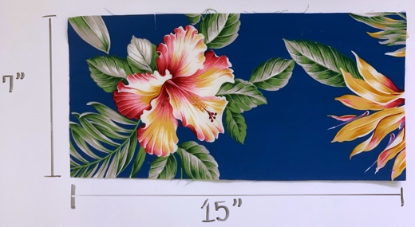
Step 1
Cut out two 7’’ x 15” cloths from your cotton material.

Slide 4
Step 2
Select one cloth and fold it in half.
If there is a pattern on the cloth, have the outer pattern facing outwards as seen in the clip.

Slide 5
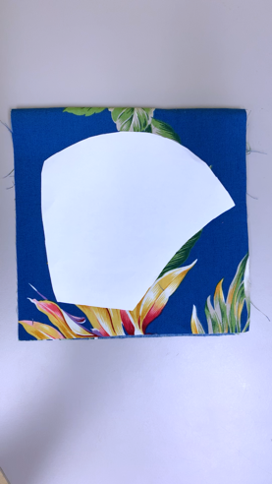
Step 3
Place CFS Mask template on the folded cloth and cut along the edges.
Helpful hint: You can outline the template and cut with scissors/exacto knife / rotary cutter.

Slide 6
Step 4
You should have a two cut out pieces that mirror each other as seen in the clip.

Slide 7
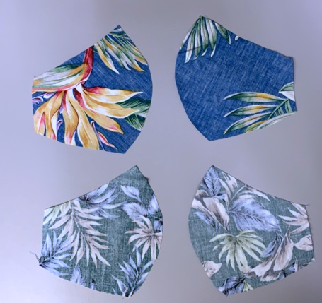
STEP 5
Repeat steps 2,3,4 with the second 7” x 15” cloth.
You should now have a total of 4 pieces of fabric using this template.
You should now have two sets of mirror images.

Slide 8
STEP 6
Take one fabric set and flip. The inside design should now be facing outside.
Do this for both fabric sets.

Slide 9
STEP 7
Grab your ruler and identify 3/8^{th ‘’} inch seam from the rounded edge on both sets.

Slide 10
Step 8
Sew along the 3/8th” edge.
Do this for both sets.

Slide 11
Step 9
Clip small notches into the fabric on the outer part of the 3/8th seam.
Fun Fact: This will reduce bulk of the seam.

Slide 12
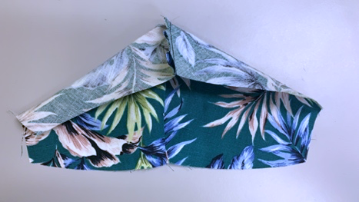
Step 10
Select one of the newly sewn pieces and open.

Slide 13
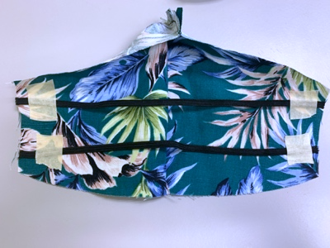
Step 11
Place elastic bands horizontally along the open mask. 3/8th “ from the top.
Repeat the same process along the bottom of the mask.
Helpful hint: I like to use paper tape to hold the elastic bands into place.

Slide 14
Step 12
Take your second cloth piece and place it on top of the elastic bands.
Make sure that the cloth set mirrors each other as seen in the clip.

Slide 15
Step 13
Begin sewing the edges together. Leave a small space unsewn as seen in the image.
This unsewn portion will be used to turn the fabric inside out.

Slide 16
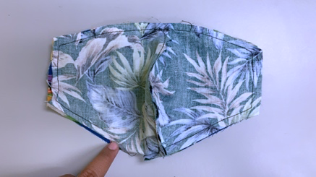
Step 14
After sewing the edges around the two pieces. You should have an open unsewn portion.
Turn the fabric inside out through this open slot.
See image.

Slide 17
Step 15
Once the cloth is turned inside out sew the open slot.
Clip any excess threads. And iron the cloth.

Slide 18
ENJOY YOUR REVERSIBLE MASK

